Slide 1
(More) Logic Circuits

Slide 2
Power Plant Example:
A power plant has an alarm system where it goes off when the water tank sensor is at a low level, at which the sensor produces a 0 (for low level), or when the heat is too high at which the heat sensor produces a 1, and the fan malfunctions at the same time the heat is too high, (the fan sensor produces a 0 for broken). Create the proper circuit, if the alarm takes in a 1 to sound.
Break it down into statements then “search for the truth”

Slide 3
Power Plant Example:
Four Machines:
Water Level Sensor
Heat Sensor
Fan Sensor
Alarm

Slide 4
Power Plant Example:
Search for the 1
(That is the TRUTH)
Water Level Sensor
When the water level is low the sensor sends a 0
When the water is not low the sensor sends a 1
This phrase:
W=“The water is not low”

Slide 5
Power Plant Example:
Heat Sensor
When the heat is too high the sensor sends a 1
When the heat level is fine the sensor sends a 0
This phrase:
H=“The heat is too high”

Slide 6
Power Plant Example:
Fan Sensor
When the Fan is Broken the sensor sends a 0
When the Fan works the sensor sends a 1
This phrase:
F=“The fan works”

Slide 7
Power Plant Example:
Alarm
When the alarm receives a 1 the alarm turns ON
When the alarm receives a 0 the alarm turns OFF
This phrase:
A=“The Alarm is on”

Slide 8
Power Plant Example:
A power plant has an alarm system where it goes off when the water tank sensor is at a low level, at which the sensor produces a 0 (for low level), or when the heat is too high at which the heat sensor produces a 1, and the fan malfunctions at the same time the heat is too high, (the fan sensor produces a 0 for broken). Create the proper circuit, if the alarm takes in a 1 to sound.
This means: “AND”

Slide 9
Power Plant Example:
So given: W=“Water is not low” (water sensor “says”)
H=“Heat is too high” (heat sensor “says”)
F=“The Fan works” (fan sensor “says”)
Write the statement in logic symbols:
The Water is low or both the fan is broken and the heat is too high.

Slide 10
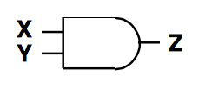
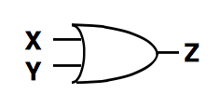
Recall:
AND
OR
NOT

Slide 11
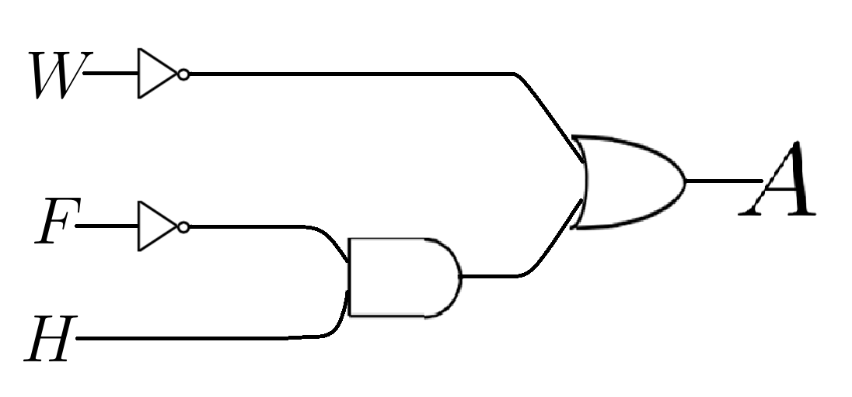
Power Plant Example:
NOT
OR
NOT
AND

Slide 12
Group Work: (Bio-Remediation)
Your Geology professor heard that you took an awesome math class that taught you how to design logic circuits and asks for your help.
The Professor is designing an experiment to show a correlation with a certain type of microbe and the presence of oil in the soil. In this experiment the lab technician will put a sample of soil into a box that has two sensors. The first sensor detects if the sample is free of oil and returns a 1 when there is no oil. The other sensor detects if the microbe is present in the sample and returns a 1 if the microbe is in the soil.
The Professor would like you to make a circuit which connects the two sensors from the box to a green a light, which will turn on when it receives a 1, and off when it receives a 0, so that the eager graduate student outside the box can write down that the light turned green.

Slide 13
Group Work: (Power Plant 2)
A power plant has an alarm system where it goes off when the water tank sensor is at a low level (at which the sensor produces a 0 for low level) and at the same time the water pump is broken (for which the pump sensor produces a 0 for broken), or when the heat is too high at which the heat sensor produces a 1, and the fan malfunctions at the same time the heat is too high, (the fan sensor produces a 0 for broken). Create the proper circuit, if the alarm takes in a 1 to sound.

